Slide 1

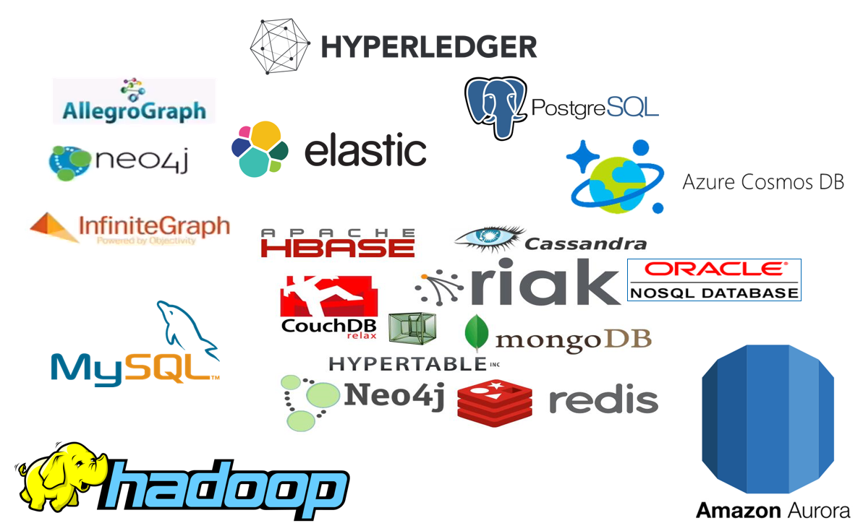



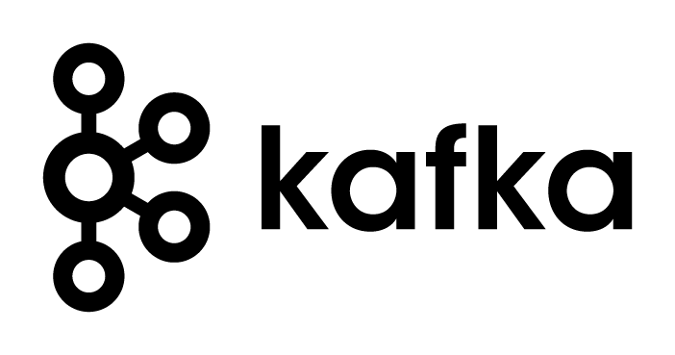



Introducing Apache Kafka The Event Fabric – tying everything together
µ
µ
Fontys Hogeschool – woensdag 24 maart 2021
Lucas Jellema, CTO & Architect AMIS | Conclusion
Session Resources: bit.ly/fontys-kafka21

Slide 2

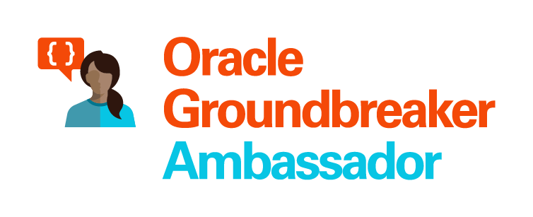

Lucas Jellema Architect / Developer 1994 started in IT at Oracle 2002 joined AMIS | Conclusion Currently CTO & Solution Architect

Slide 3
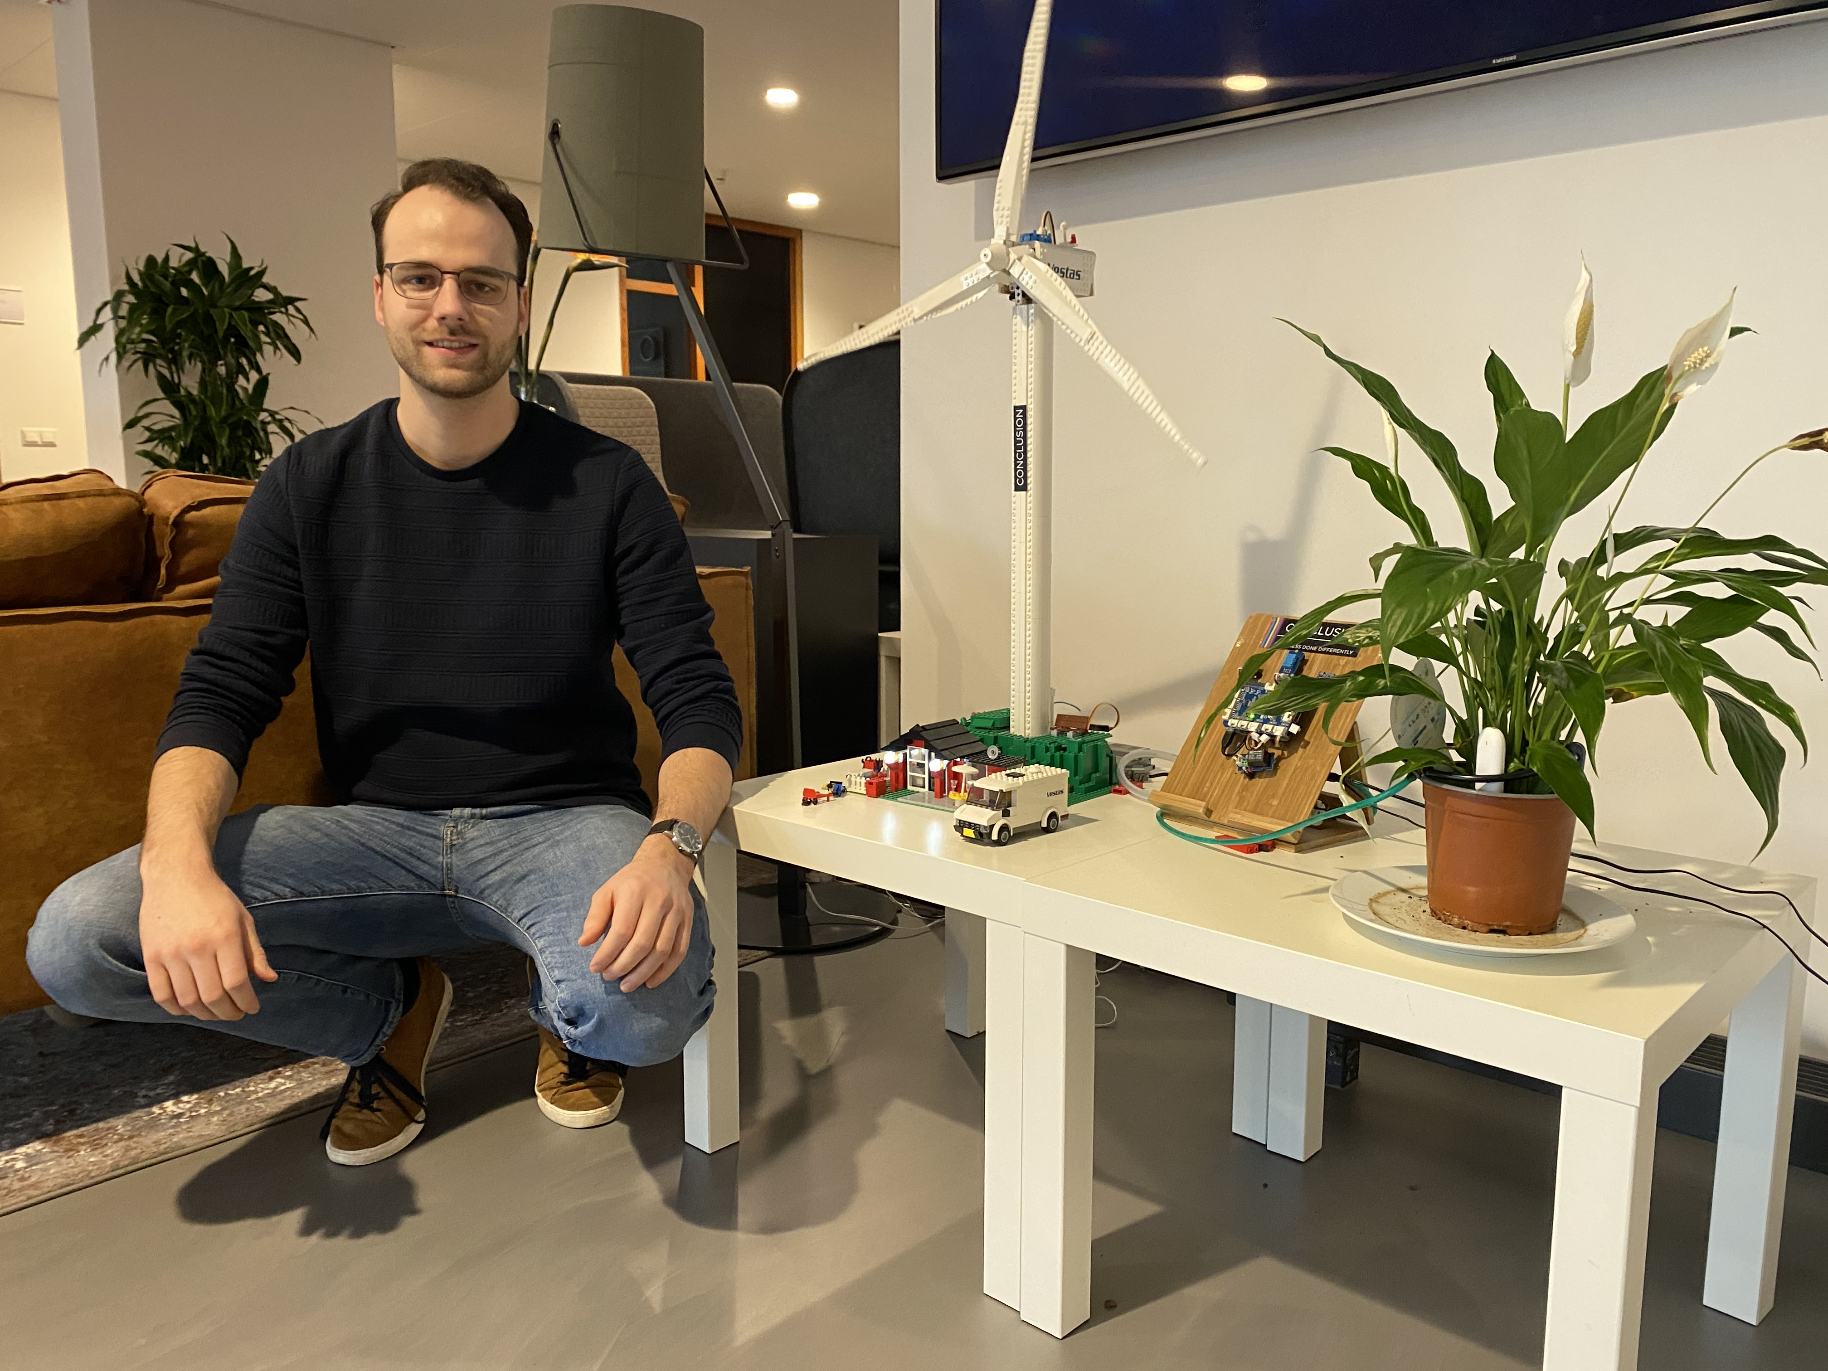
Jouw carrière goed beginnen bij AMIS?
Meewerkstage
Werk een periode mee en stel al je moeilijke vragen aan één van onze 80 IT-professionals die jou graag verder helpen.
Afstudeerstage
Kom afstuderen bij AMIS en doe onderzoek naar uiteenlopende onderwerpen waarbij je begeleiding krijgt van onze collega’s.
Afgestudeerd? Jouw eerste baan!
Januari 2021: Afstudeerder (en inmiddels collega) Niels en zijn onderzoek naar “Een generieke oplossing voor Internet of Things (IoT) systemen’.
Afgestudeerd en wil jij jouw carrière gelijk goed beginnen? Treed in dienst als Junior Consultant bij AMIS. Samen met ervaren collega’s leer je de praktijk écht goed kennen.
Neem contact op met Marcel Bargeman:
Wil je meer weten over stagelopen of werken bij AMIS? Neem contact op met Marcel Bargeman, onze recruiter: marcel.bargeman@amis.nl

Slide 4
Overview
What is Apache Kafka? Core concepts and technology
Lab 1 – First hands-on with Apache Kafka
Programming
Brief introduction of Node (JS)
Lab 2 – Programmatic interaction with Apache Kafka
Shades of Data – Streaming, CQRS, Event Sourcing
The Eneco Case – The Event Streaming Platform
Lab 3 – DIY CQRS
Microservices and the quest for decoupling
Lab 4 – Microservices Interaction and Choreography
But wait – there is more:
Ecosystem and supporting tools
Alternative offerings (public cloud and stand-alone)

Slide 5


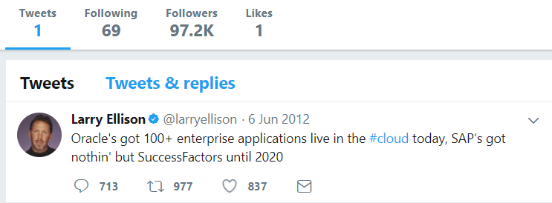
Heck, I do not even know these people and they may not know me [personally] – just my pearls of wisdom. And if they are late to the party, they can also check out the historic archives of my eloquence
Without fretting about the numbers of readers involved and whether they are in the same time zone as me and online when I publish my messages – and which device they use
It would be so nice if I could publish my ideas and actions, accessible near instantly for everyone who is interested

Slide 6
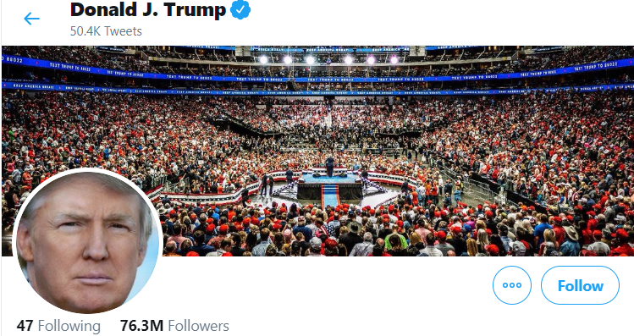
Heck, I do not even know these people and they may not know me [personally] – just my pearls of wisdom. And if they are late to the party, they can also check out the historic archives of my eloquence
Without fretting about the numbers of readers involved and whether they are in the same time zone as me and online when I publish my messages – and which device they use
It would be so nice if I could publish my ideas and actions, accessible near instantly for everyone who is interested

Slide 7

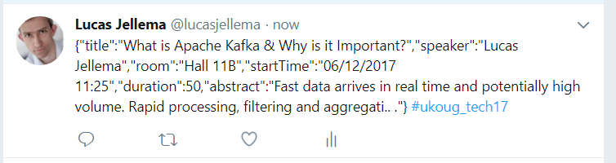
Decoupled communication
0, 1 or many followers
Scalable number of messages (and parties)
Reliable (mostly available, few messages lost)
Full history
Open: cross device, cross location
Not Sub-second, near real-time fast
Rate limited (#messages/minute)
Size limited (140-280 characters)
Format limited (text)
Not for private interactions
Not (really) for programmatic use

Slide 8
What does the Twitter for System Driven Event Interaction look like?
Decoupled communication – organized per topic
0, 1 or many Consumers per Topic
Scalable number of messages (and parties)
Reliable (distributed)
Full history
Open: libraries in many technologies & REST APIs

Slide 9
What does the Twitter for System Driven Event Interaction look like?
Decoupled communication – organized per topic
0, 1 or many Consumers per Topic
Scalable number of messages (and parties)
Reliable (distributed)
Full history
Open: libraries in many technologie & REST APIs
Near real-time fast
No Rate Limit
No enforced size limit
Anything goes (it’s all byte[])
On premises or in cloud, private or trusted
Very much for programmatic use

Slide 10
Events
Consumers
Producers
Robust, Scalable, Fast, History Retention
Containerized/Cloud-enabled
Open

Slide 11
Messaging as we know it
JMS, Oracle Advanced Queuing, IBM MQ, MS MQ, RabbitMQ, MQTT, XMPP, WebSockets, Apache ActiveMQ, AMQP , …
Challenges
Costs
Scalability (size and speed)
(lack of) Distribution (and therefore availability)
Complexity of infrastructure
Message delivery guarantees
Lack of technology openness
Deal with temporarily offline consumers
Retain history

Slide 12

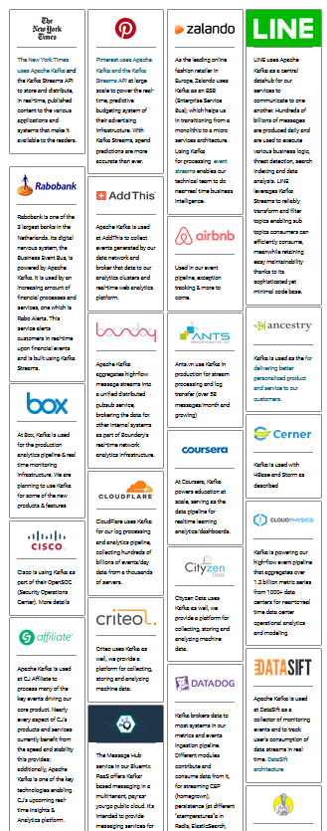

Introducing Apache Kafka
..- 2010 – creation at Linkedin
Message Bus | Event Broker
High volume, low latency, highly reliable, cross technology
Scalable, distributed, strict message ordering, ….
2011/2012 – open source under the Apache Incubator/ Top Project
Kafka is used by many large corporations:
Walmart, Cisco, Netflix, PayPal, LinkedIn, eBay, Spotify, Uber, Sift Science, Zalando, The New York Times, Airbnb, Coursera, ING Bank,…
And embraced by many software vendors & cloud providers
Client libraries available for Node, Java, C/C++, Python, Ruby, PHP, Go, Rust, .NET, Perl, Scala DSL, Clojure, Swift and more
Commercial backing by and Enterprise support from Confluent

Slide 13
Consumers
tcp
Producers
tcp

Slide 14
Consumers
Producers
Topic

Slide 15
Kafka terminology
Topic
Message
== ByteArray
Broker
Producer
Consumer
Message
Key
Value
Time
Producer
Consumer
Broker
Topic

Slide 16
Key
Value
Time
Consumers
Producers
Broker
Topic

Slide 17
Consuming
Messages are available to consumers only when they have been committed
Kafka does not push
Unlike JMS
Read does not destroy
Unlike JMS Topic
(some) History available
Offline consumers can catch up
Consumers can re-consume from the past
Delivery Guarantees
Ordering maintained
At-least-once (per consumer) by default; at-most-once and exactly-once can be implemented

Slide 18

Het Bedrijfsprikbord
!
!
!
!!
!!
“@#”

Slide 19



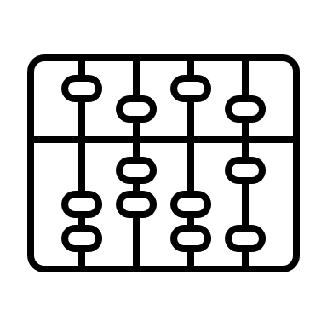

Het Bedrijfsprikbord
!
€
!
!!
“@#$”
$
¥ ₤ ₨

Slide 20
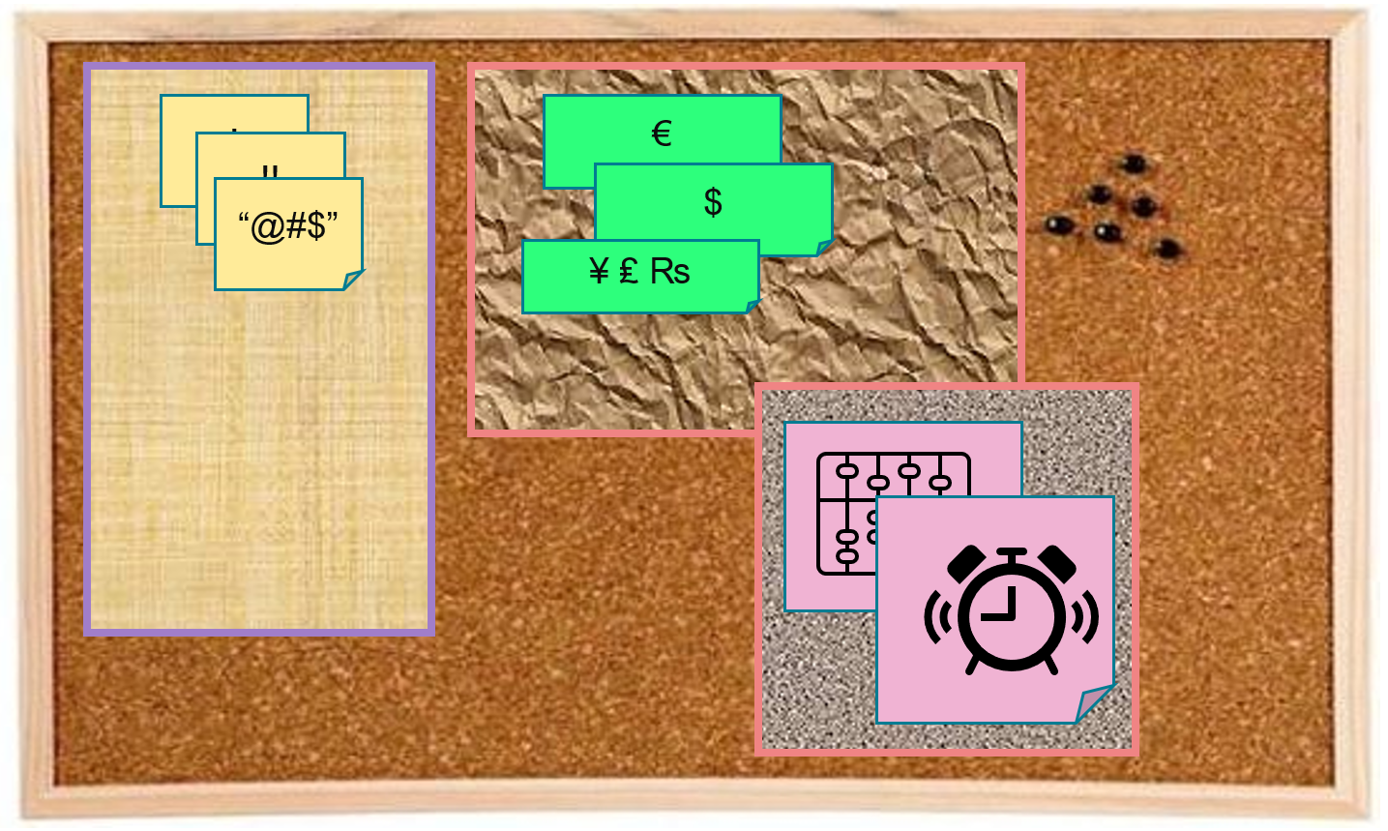
Key
Value
Time
Consumers
Producers
Broker
Topic
Message Log

Slide 21


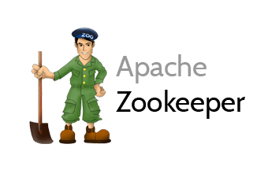
Cluster
Consumers
tcp
Producers
tcp
Broker
Topic
Partition
Consumer Group
Partition Log
Replica

Slide 22
What’s so special?
Durable transactions
Scalable
High volume
High speed
Available
Distributed
Open
Quick start
Free (no license costs)
“Self Fulfilling Prophecy” (positive feedback loop feeding from buzz around Kafka)
Eco system, tools/libraries/resources, cloud services

Slide 23
Overview
What is Apache Kafka? Core concepts and technology
Lab 1 – First hands-on with Apache Kafka
Programming
Brief introduction of Node (JS)
Lab 2 – Programmatic interaction with Apache Kafka
Shades of Data – Streaming, CQRS, Event Sourcing
The Eneco Case – The Event Streaming Platform
Lab 3 – DIY CQRS
Microservices and the quest for decoupling
Lab 4 – Microservices Interaction and Choreography
But wait – there is more:
Ecosystem and supporting tools
Alternative offerings (public cloud and stand-alone)

Slide 24
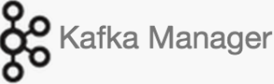



Lab Environment
2181
9092
9093
9094
Docker Compose
kafka
28044
28042
Browser
Laptop
localhost
Lab Resources: bit.ly/fontys-kafka21

Slide 25

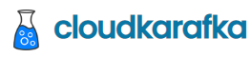
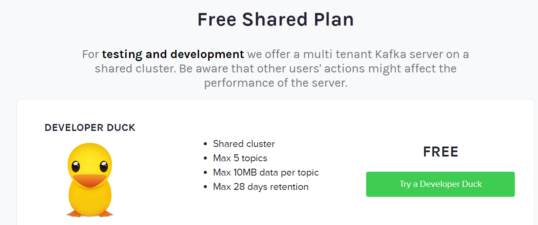
Partly Clouded Lab Environment
2181
CloudKarafka Console
www.cloudkarafka.com/plans.html
Browser
Laptop
localhost
Lab Resources: bit.ly/fontys-kafka21

Slide 26
Quick Demo – Apache Kafka through Kafka Console
Show interaction at the most basic level
Broker
Topic
partition
Produce Message
Consume Message
Consumer Group
Lab Resources: bit.ly/fontys-kafka21

Slide 27
Lab 1: First steps with Apache Kafka
Using Kafka Console
Create a topic
Publish messages to topic
Using Kafka Console
Consume messages from topic
Work with Apache Kafka HQ GUI to
inspect the Kafka Cluster
produce additional messages
consume message from a special Consumer Group
9092
Docker Compose
kafka
28042
Browser
Laptop
localhost
Lab Resources: bit.ly/fontys-kafka21

Slide 28
Overview
What is Apache Kafka? Core concepts and technology
Lab 1 – First hands-on with Apache Kafka
Programming against Apache Kafka
Brief introduction of Node (JS)
Lab 2 – Programmatic interaction with Apache Kafka
Shades of Data – Streaming, CQRS, Event Sourcing
The Eneco Case – The Event Streaming Platform
Lab 3 – DIY CQRS
Microservices and the quest for decoupling
Lab 4 – Microservices Interaction and Choreography
But wait – there is more:
Ecosystem and supporting tools
Alternative offerings (public cloud and stand-alone)

Slide 29
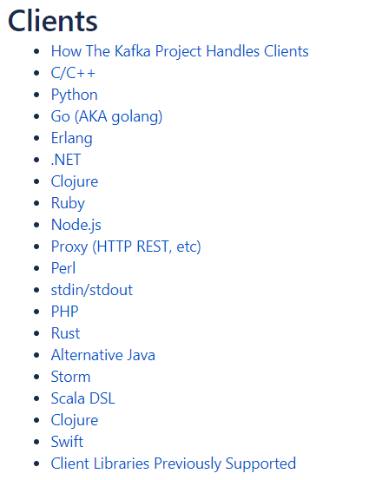





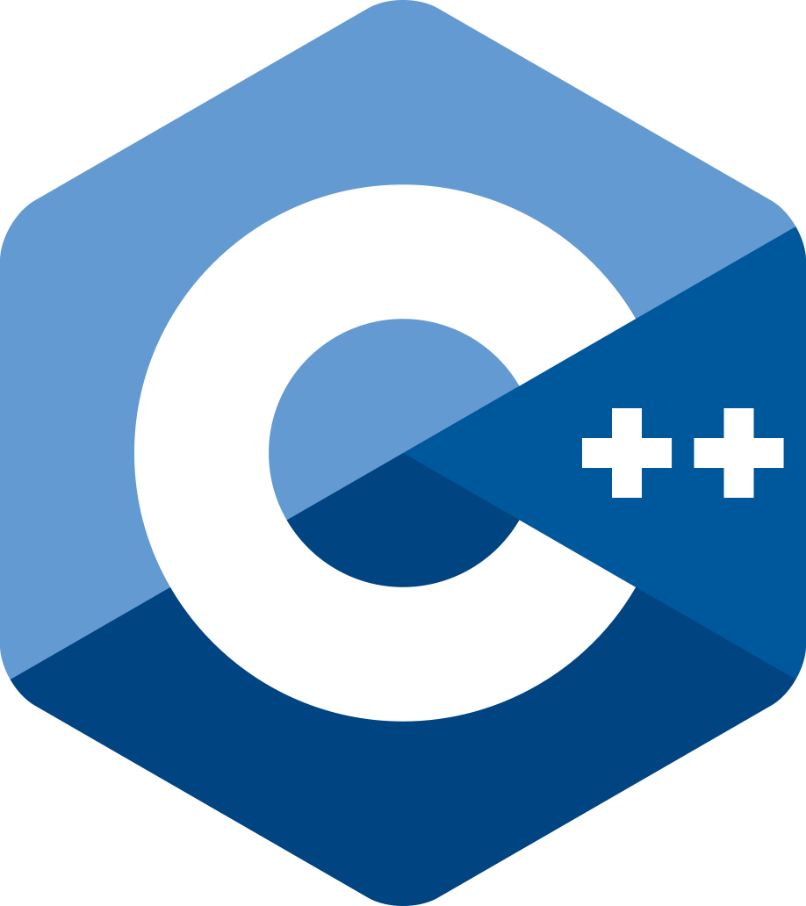





Programming against Kafka: Client Libraries
Client libraries
C/C++
Python
Go
Java
.NET
JavaScript/Node
Ruby
Scala
and more..
Also: REST Proxy (part of open source Confluent Platform)
Produce, Consumer and manage through REST API calls
Notes:
https://cwiki.apache.org/confluence/display/KAFKA/Clients

Slide 30
Programming against Kafka: Typical Steps in a Client Producer Application
Create a connection
connected to one or more brokers in a cluster or to the Zookeeper node
you need the broker-endpoints or the Zookeeper endpoint
optionally use credentials or certificate for authentication
Create a Producer on top of the connection
When the Producer-Connection is available…
[Optionally] Start a Transaction
Produce message[s] to topic(s) [or specific topic partition(s)]
[Optionally] Commit the Transaction
[Repeat Message Production]
Disconnect the producer/close the connection
2181
9092
9093
9094
Client
Application
Notes:
https://cwiki.apache.org/confluence/display/KAFKA/Clients

Slide 31
Programming against Kafka: Typical Steps in a Client Consumer Application
Create a connection
connected to one or more brokers in a cluster or to Zookeeper node
you need the broker-endpoints or the Zookeeper endpoint
optionally use credentials or certificate for authentication
Create a Consumer or a ConsumerStream on top of the connection
Subscribing to one or more topics
[Optionally] Associating with a Consumer Group
(Which leads to a link to one or topic more partitions on the Kafka brokers)
[Optionally] Overriding the auto-commit
When the Consumer or Stream is available…
Consume message[s] (from the specified subscriptions)
[Optionally, depending on auto-commit poperty] Commit the Transaction
[Repeat Message Consumption]
Disconnect the consumer/close the connection
2181
9092
9093
9094
Client
Application
Notes:
https://cwiki.apache.org/confluence/display/KAFKA/Clients

Slide 32


Introducing Node
JavaScript dates back to mid 1990s and the Netscape Navigator browser
NodeJS was born in 2009:
Server Side JavaScript
Based on V8 Javascript Engine
Using npm as package and build manager
Simple, light weight, faster developer feedback, leveraging 15 years of web development
2010: Express – framework for REST APIs
2010-2021: many Node libraries, drivers, modules appear
Core component in MEAN-stack (MongoDB, Express, Angular, NodeJS)
Node (JavaScript) is one of the primary runtime engines for Serverless Functions
On all major cloud providers (AWS, Azure, GCP, Oracle Cloud Infrastructure)

Slide 33
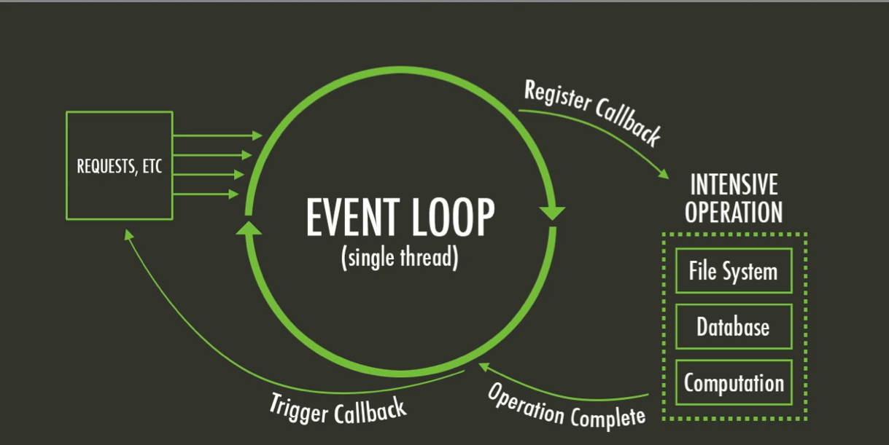
Introducing Node – Single Thread model
Multi-thread languages – such as Java – typically block when file system or network operations take place
Parallel processing continues in parallel threads
Threads consume resources and are only somewhat scalable
JavaScript has a main (single thread) event loop and uses asynchronous processing
Non-blocking handling of file system interactions, HTTP calls, network operations and other blocking actions
Scalable, very quick startup

Slide 34
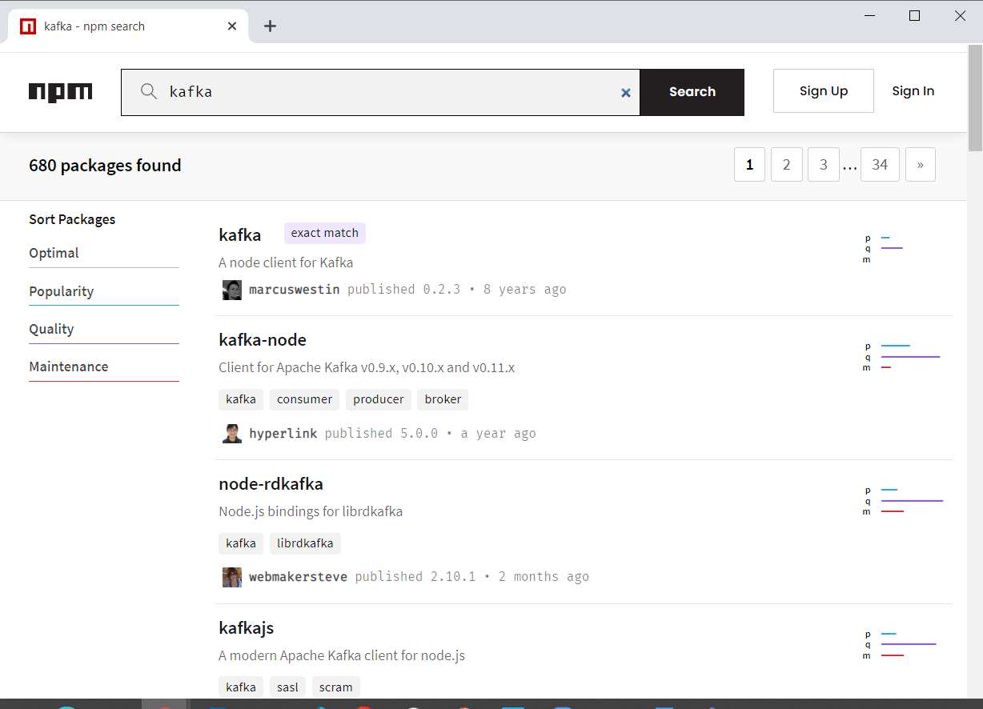
Introducing Node
NPM = Node Package Manager
To include libraries from the ecosystem
Leverages npm registry (> 1.3M NPM Modules available)
Acquired by Microsoft – March 2020
To build and run Node applications
similar to Maven & Gradle (Java) or pip (Python)
Yarn and Turbo are popular alternatives
Notes:
http://www.modulecounts.com/

Slide 35
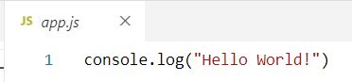
Hello World in Node
index.js
with the code to execute
(optional) package.json
with NPM dependencies, build and run configuration (compare Maven pom.xml)
Create Node application:
npm init (optional, you can just create a text file by hand)
Run Node application
node index.js
npm start
Add dependencies
npm install <name of module> --save

Slide 36
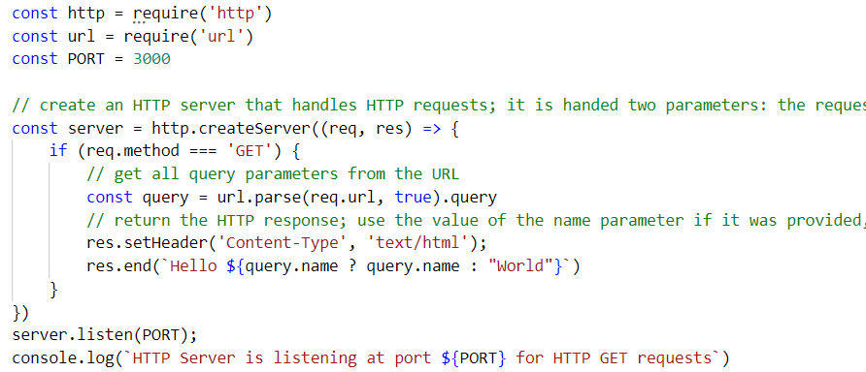
Hello World Web Application
Node is very good at handling HTTP Requests
And at making them
It is a great technology to implement REST APIs and backends for Web and Mobile applications

Slide 37
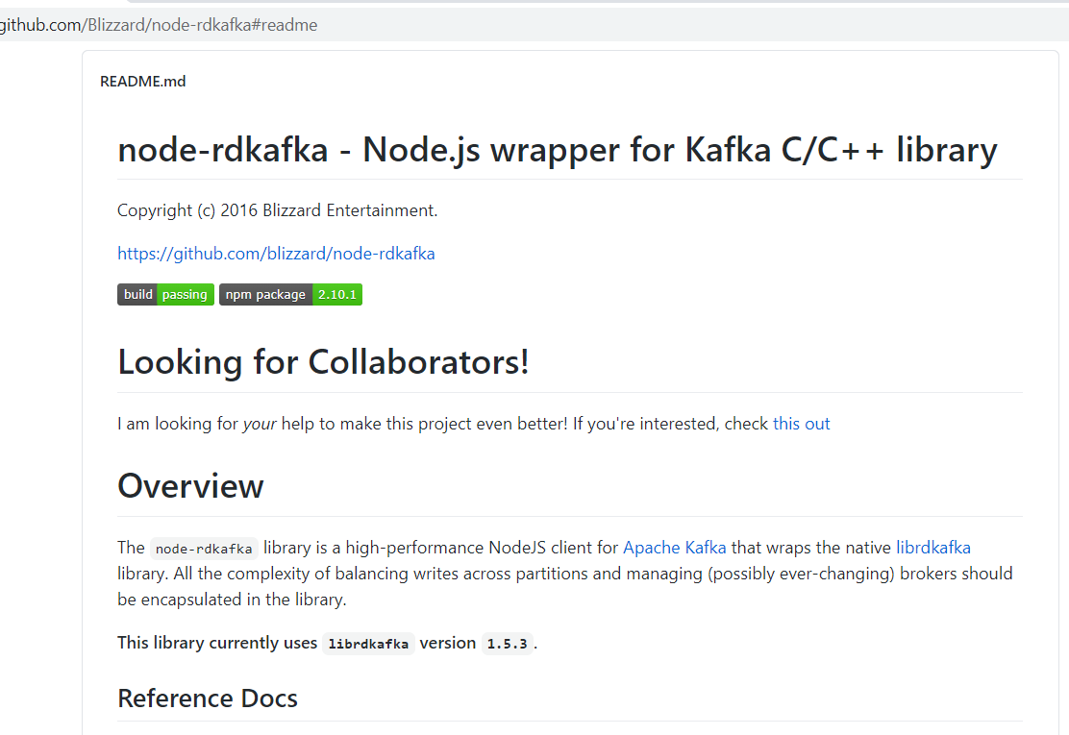
Node and Kafka
We will use NPM module node-rdkafka to facilitate the interaction with Apache Kafka from our Node application
This module leverages a C/C++ library for Kafka interactions

Slide 38
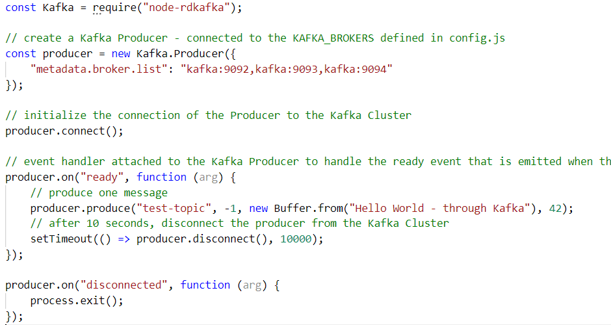
Node and Kafka – a simple producer

Slide 39
Node and Kafka – a simple producer

Slide 40
Node and Kafka – a simple producer

Slide 41
Node and Kafka – a simple producer

Slide 42
Node and Kafka – a simple producer

Slide 43
Node and Kafka – a simple producer

Slide 44
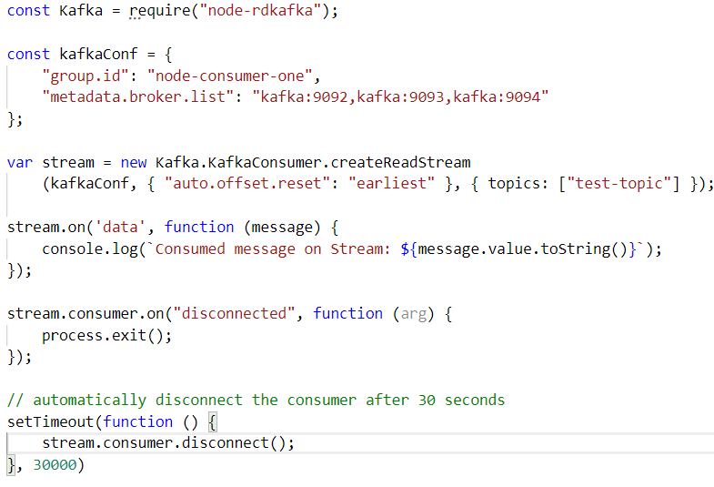
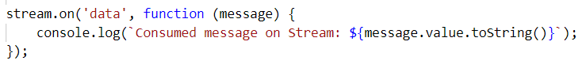
Node and Kafka – a simple consumer

Slide 45
Overview
What is Apache Kafka? Core concepts and technology
Lab 1 – First hands-on with Apache Kafka
Programming against Apache Kafka
Brief introduction of Node (JS)
Lab 2 – Programmatic interaction with Apache Kafka
Shades of Data – Streaming, CQRS, Event Sourcing
The Eneco Case – The Event Streaming Platform
Lab 3 – DIY CQRS
Microservices and the quest for decoupling
Lab 4 – Microservices Choreography
But wait – there is more:
Ecosystem and supporting tools
Alternative offerings (public cloud and stand-alone)

Slide 46
Lab 2 – Programmatic interaction with Apache Kafka
Prequisite: local Node runtime
Step One:
Hello World in Node
Step Two:
Node application to Produce Messages to Kafka Topic
Node application to Consume Messages from Kafka Topic
Bonus Step Three:
Node Web Application to Produce Messages from HTTP Request
Node Web Application to return Messages on Topic in HTTP Response

Slide 47
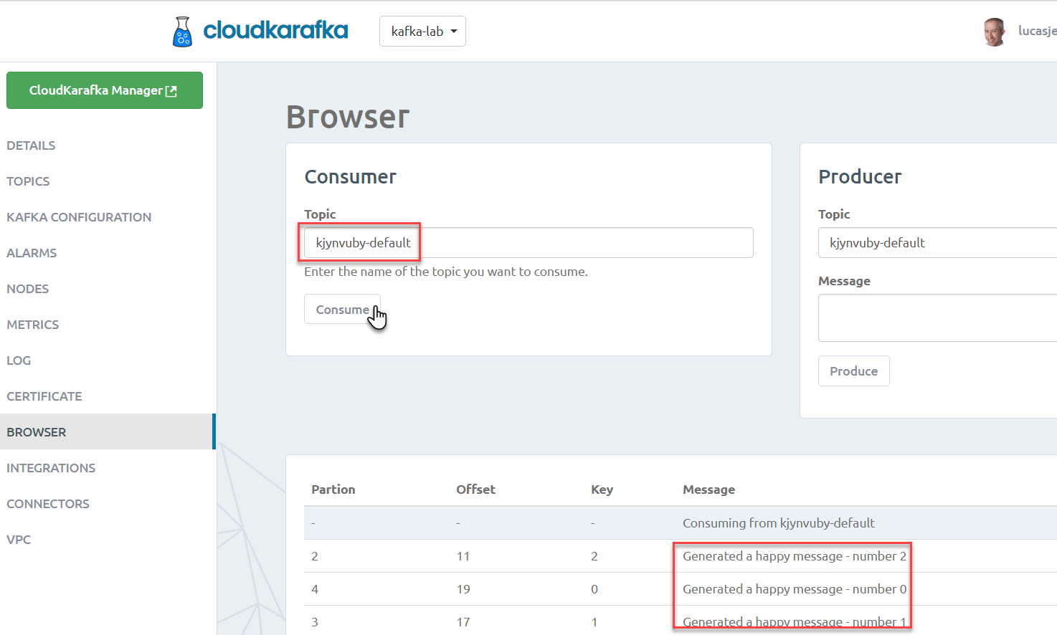
kjynvuby-default
Consume
Produce

Slide 48
Overview
What is Apache Kafka? Core concepts and technology
Lab 1 – First hands-on with Apache Kafka
Programming against Apache Kafka
Brief introduction of Node (JS)
Lab 2 – Programmatic interaction with Apache Kafka
The Eneco Case – The Event Streaming Platform
Shades of Data – Streaming, CQRS, Event Sourcing
Lab 3 – DIY CQRS
Microservices and the quest for decoupling
Lab 4 – Microservices Choreography
But wait – there is more:
Ecosystem and supporting tools
Alternative offerings (public cloud and stand-alone)

Slide 49
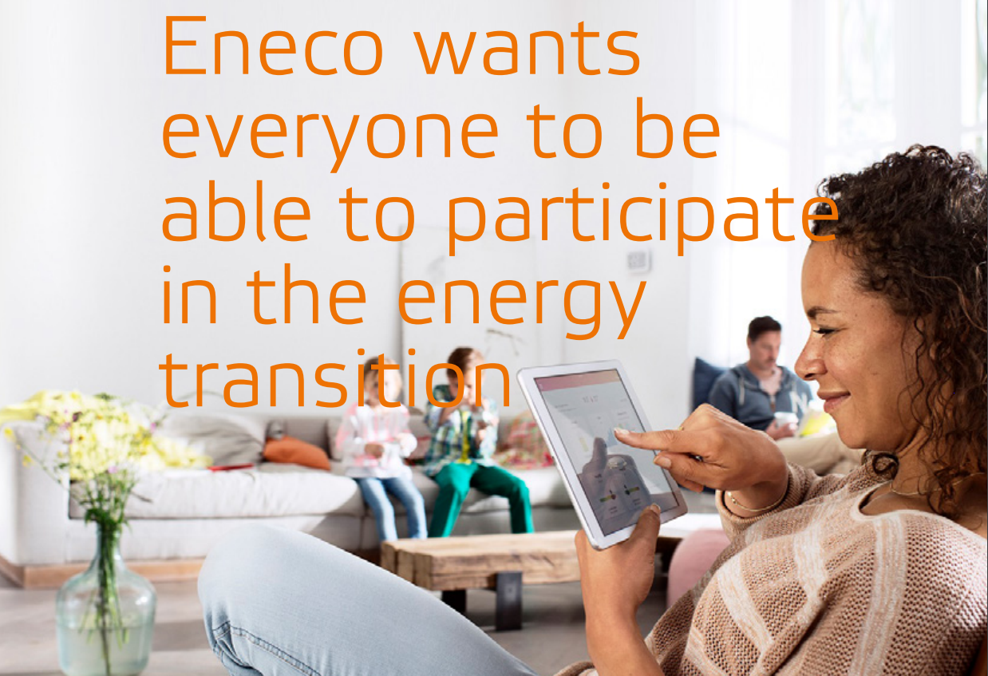
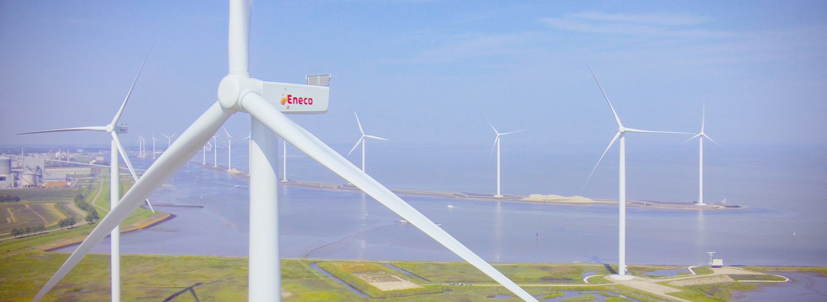
Eneco – Utility company
Interesting mix of operational, real time systems in physical environments, large scale enterprise systems for 1000s of internal professionals and millions of external consumers – with a mission to improve the world

Slide 50









Utility Company looking for Performance, Scalability and Availability in their core data sets
Marketing Campaigns
Invoicing
CRM
Billing
batch
Meter Readings
Load on Core Systems & effect on Performance
Availability Core Systems

Slide 51
Utility Company looking for Performance, Scalability and Availability in their core data sets
Marketing Campaigns
CRM
Invoicing
CRM Cache DB
Meter Readings
Billing
Meter Readings Cache DB

Slide 52
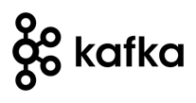
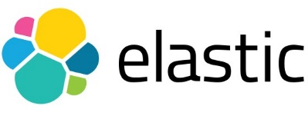

Utility Company looking for Performance, Scalability and Availability in their core data sets
Marketing Campaigns
CRM
Invoicing
CRM Cache DB
Meter Readings
Billing
Meter Readings Cache DB

Slide 53
Practical Challenges
Marketing Campaigns
Publish all change events from sources
Event schema evolution
Lag in Cache Databases
“eventual consistency”
Differences between sources and cache databases
Initial creation of Cache Databases
General Scale and Incidental event storm
Business and Mission Critical availability
Data Authorization
Logic enforced in source (applications)
GDPR
CRM
Invoicing
CRM Cache DB
Meter Readings
Billing
Meter Readings Cache DB

Slide 54
CQRS

Slide 55
CQRS
Products
Data Manipulation
Data Retrieval

Slide 56

Same Data, Multiple – different – Usage Scenarios
Different in:
Why
What – grain, aggregation, breadth, type of and variation in queries
How – format, language, accuracy and freshness, consistency
When – frequency, time of day | week | month, 24/7
Where – latency, band width, off line
Who – scale, different roles & user groups

Slide 57
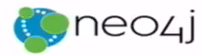




CQRS: Command Query Responsibility Segregation
Products
Data Manipulation
Quick Product Search Index
Special Products
Data Retrieval
Toys
Product Clusters
Product Store in SaaS app
Food Stuff
Notes:
Data manipulation and retrieval in separate places
(physical data proliferation)
Query store is optimized for consumers
Level of detail, format, filters applied
For performance and scalability, independence, productivity lower license fees and lower TCO, security

Slide 58
CQRS Steps and Challenges
Spot and Handle Errors
Governance & Evolution
Detect changes
Products
Extract Data
Enforce Constraints & Authorization
Data Manipulation
Transport Data
Convert Data
Special Products
Apply Data
Data Retrieval
Toys
Quick Product Search Index
Product Clusters
Food Stuff
Product Store in SaaS app
Notes:
No Event Sourcing
No events (?)
No green field
Packages Applications/SaaS
Databases (RDBMS, NoSQL) getting changes from applications directly
Challenges – at scale, with enough speed and consistently: do not let query store get into an exposed state that could not exist/be right!
Detect relevant changes
Extract relevant changes
Transport
Convert
Apply in correct order and reliably (no lost events)
Note: after detect and extract, an event can be published

Slide 59


From C to Q
How quickly?
How frequently?
How reliably?
How atomically?
Products
Quick Product Search Index

Slide 60
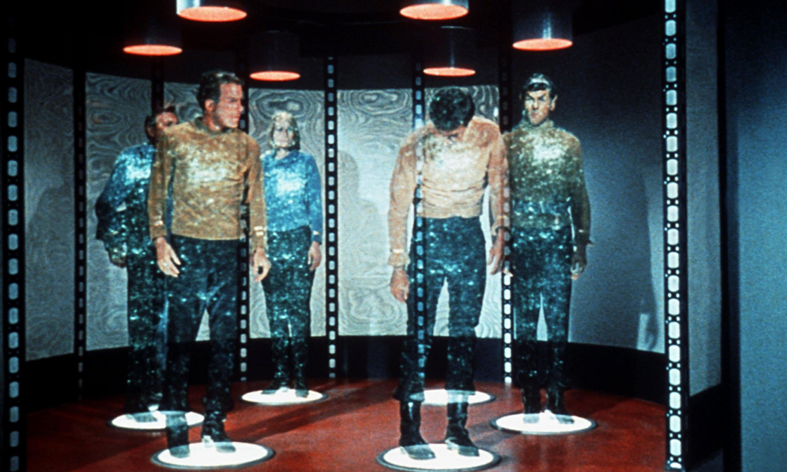

Slide 61
From C to Q
How quickly?
How frequently?
How reliably?
How atomic?
Data Authorization Considerations
Locations & Connectivity
Full resynch | restore of Query Store
Products
Quick Product Search Index

Slide 62
Typical CQRS Architecture
Source systems
Change Reporters
Distributed Change Event Hub
Change Projectors
Destination systems
Transform & Apply
Poll
Event Platform
Detect & Retrieve Change
(re)Calculate & Record
Consume
Convert, Translate, Store
Event Schema Governance
Monitoring & Error Handling
Notes:
Destination system: can be cache, or even only the programmatic representation – without any data duplication
Dumb pipes, smart end points

Slide 63
Technologies to support CQRS
Detecting and Extracting and Publishing Changes
Database specific change detection
Debezium, Kafka Connect, SOA Suite Inbound Adapters,
Cloud Adapters in iPaaS platforms and SaaS products
Decoupled gathering & queueing of change events (preferably distributed and technology agnostic; options for long term event retention)
Apache Kafka, Rabbit MQ, AWS SQS, JMS
Handling change – transport, transform, apply
Query Stores – picked based on data use case requirement, not for CQRS
Any database, in memory cache

Slide 64
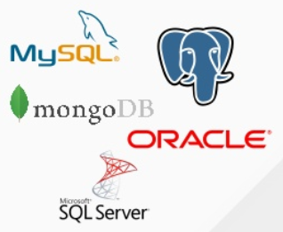

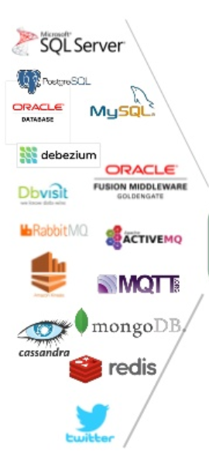


Detecting and Extracting and Publishing Changes from many sources – Debezium, Kafka Connect, Apache Kafka
CDC
Debezium
Apache Kafka
Notes:
MySQL: binlog; Postgres: wnte-ahead log; MongoDB op log

Slide 65
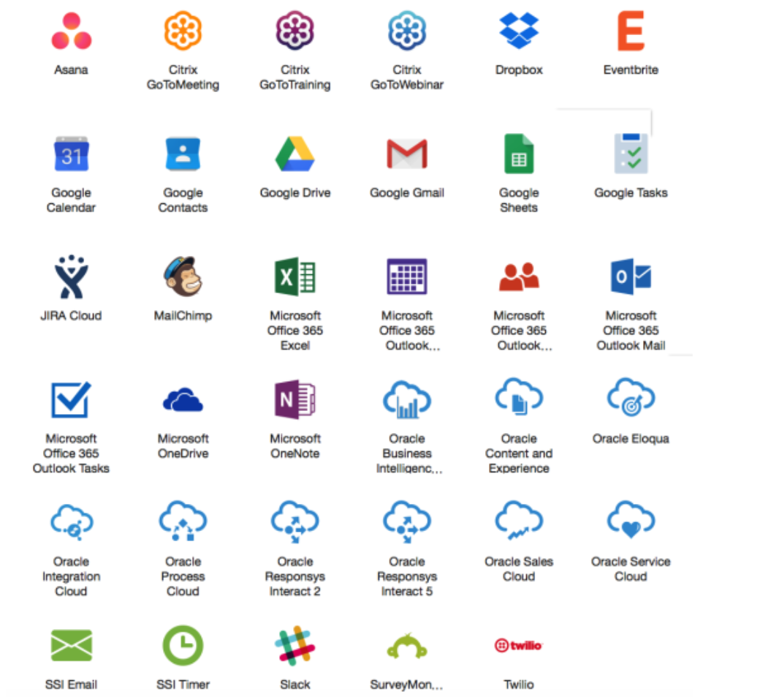
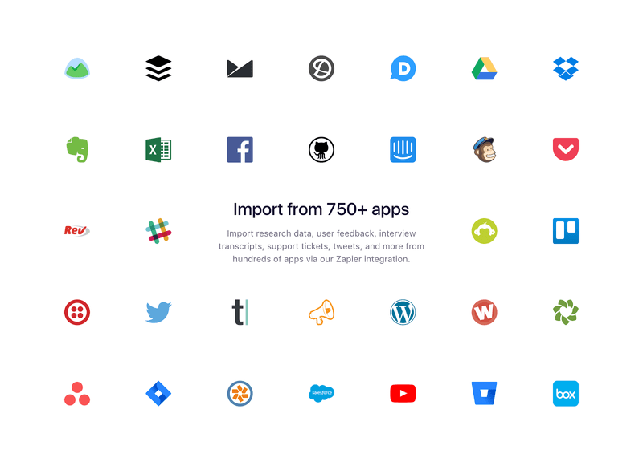
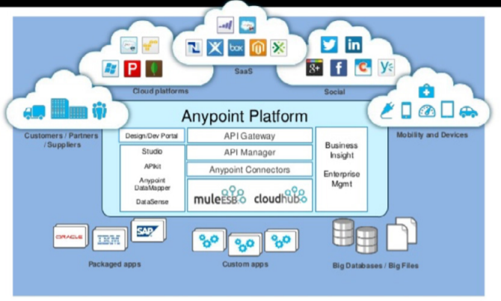
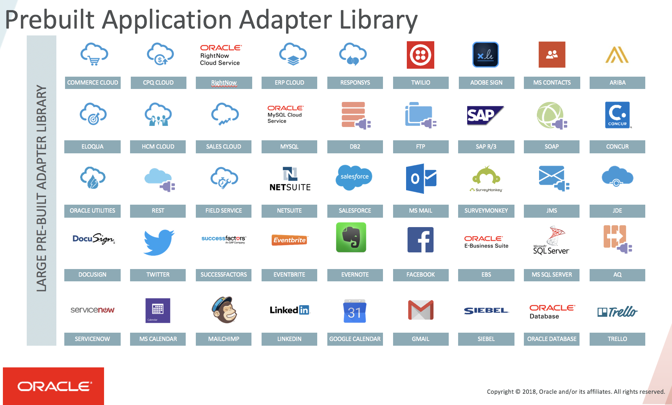
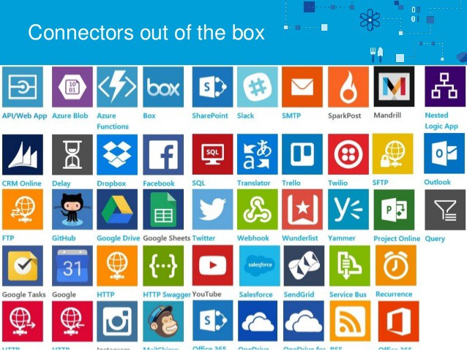
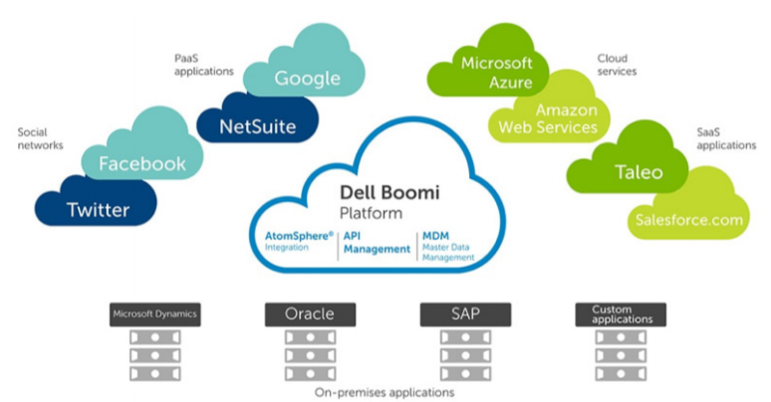
iPaaS (Cloud) Adapters for SaaS & Platform
Prepackaged Change Event Detectors
Notes:
AnyPoint
Zapier
SSI
OIC
Dell Boomi

Slide 66
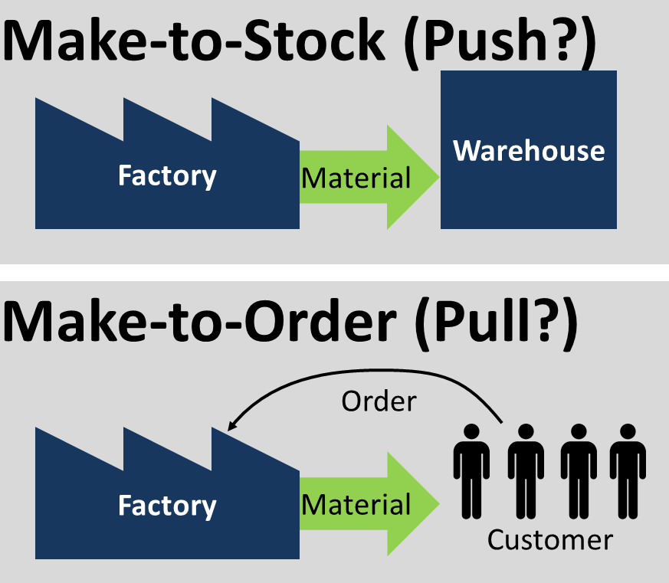
JIT vs AOT
CQRS
Truth
Failure
SPo

Slide 67
JIT vs AOT Data Integration
Just In Time
Process [synchronous] request for data ‘just in in time’
Only data that is requested
Fresh as can be
All authorization rules applied
Single Source of Truth and of Failure
Transformation & Aggregation at request time
Hard (runtime) dependencies from consumer on producer
Ahead Of Time (CQRS)
Pre-process / pre-share data ‘ahead of time’
Potentially includes data that will never be requested
Data can be outdated
Data is ready to go (easy and quick to get) and tailor made for use case

Slide 68
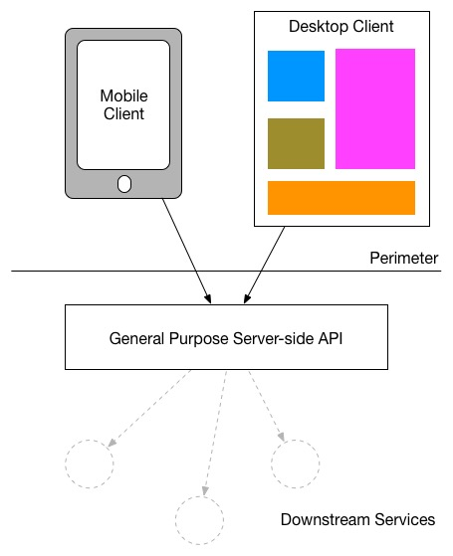
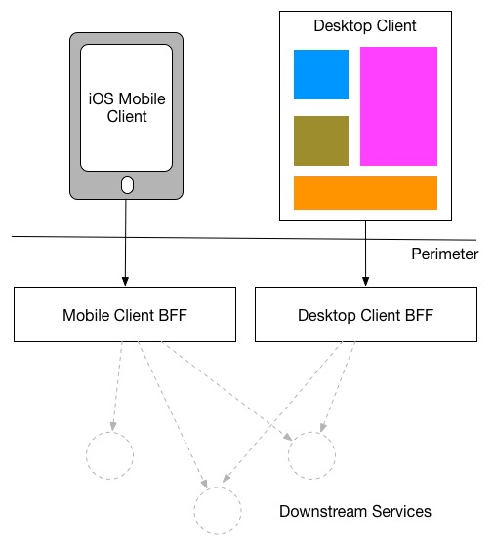
Backend For Frontend

Slide 69

CQRS => Data Backend For Frontend: Optimized data set for special use case
Shape & Format
Right Grained (aggregation, consolidation)
Filtered
Enriched (from multiple sources)
Location
Time (refreshed at the right time)
Search Options
BASE (eventually – when? – consistent)
Authorization
GDPR
UI
APIs
(backend for frontend)
Data Store
Master Database

Slide 70
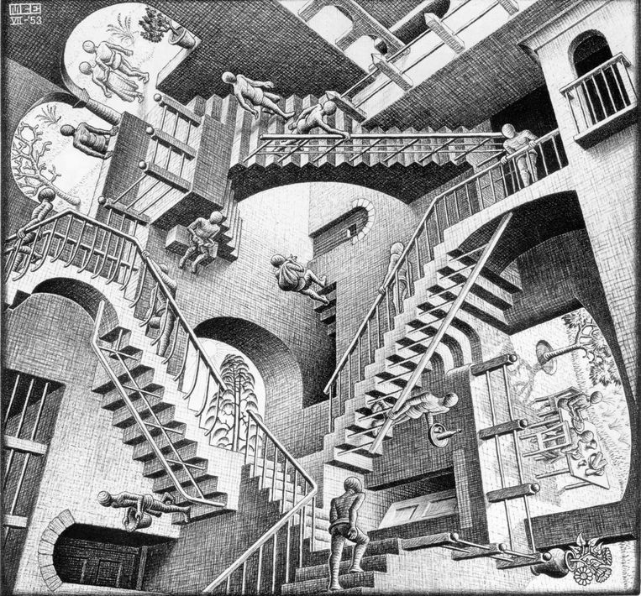
CQRS: A small step for mankind but a giant leap for [IT] architects

Slide 71
Event Sourcing

Slide 72
Utility Company: Rebuild Cache Database
CRM
CRM Cache DB
Meter Readings
Meter Readings Cache DB

Slide 73
Utility Company: Rebuild Cache Database From Event Store
CRM Cache DB
Meter Readings Cache DB

Slide 74
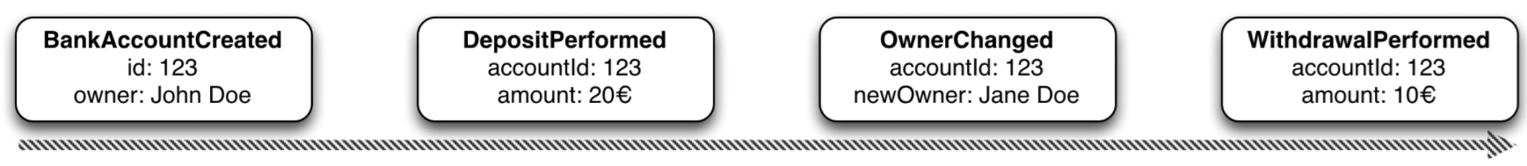
Event Sourcing Driving CQRS
amount: 10
Owner: Jane Doe
Events
Current State
Event Store
accountId: 123
Notes:
Events are immutable facts
Current state (active record) is derived from sum of events
Read optimized aggregates are created for specific use case – based on events and rebuildable at any time

Slide 75
Event Sourcing Driving CQRS
Events
Current State
Event Store
Other State Aggregate
Notes:
Events are immutable facts
Current state (active record) is derived from sum of events
Read optimized aggregates are created for specific use case – based on events and rebuildable at any time

Slide 76
Event Sourcing
Event Store is immutable – append-only log of domain state transitions
It is the truth about data – everything else is derived
Replay events
to (re)construct a representation of the current state (aggregate)
up to a specific time to recreate moments in time
in Test environment to investigate an issue
on a remote location to create mirror & share state across boundaries
produce a fine grained audit trail
Challenges
Time required to reconstruct state
Grain of aggregates / definition of domain events

Slide 77
Overview
What is Apache Kafka? Core concepts and technology
Lab 1 – First hands-on with Apache Kafka
Programming against Apache Kafka
Brief introduction of Node (JS)
Lab 2 – Programmatic interaction with Apache Kafka
Shades of Data – Streaming, CQRS, Event Sourcing
The Eneco Case – The Event Streaming Platform
Lab 3 – DIY CQRS
Microservices and the quest for decoupling
Lab 4 – Microservices Interaction and Choreography
But wait – there is more:
Ecosystem and supporting tools
Alternative offerings (public cloud and stand-alone)

Slide 78
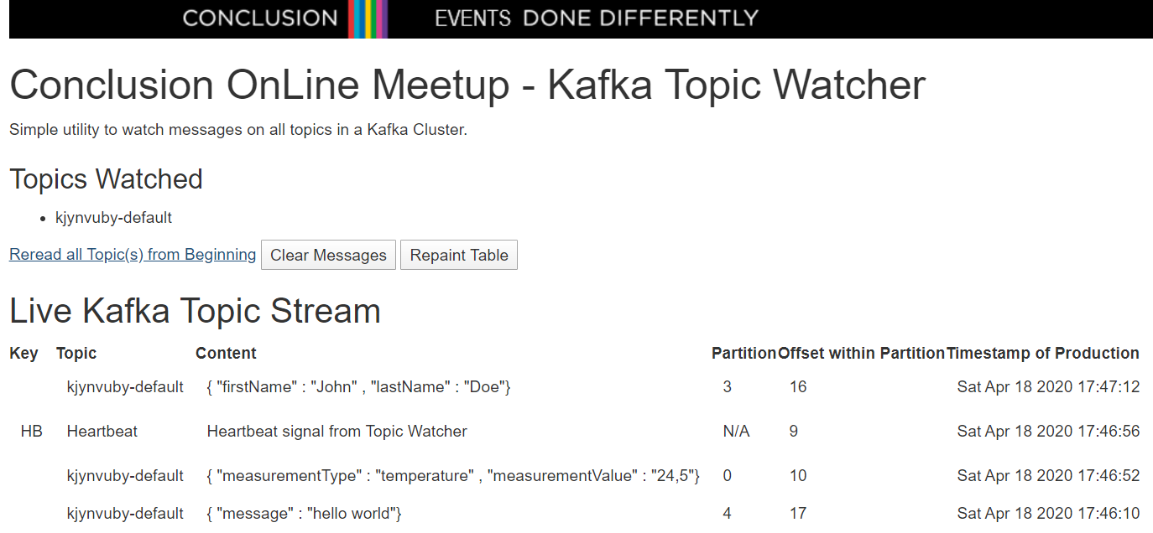
Lab 2b – The Kafka Topic Watcher
Live Messages Monitor on all Topics in a Kafka Cluster
new and historic, streamed from Topic all the way to the browser

Slide 79
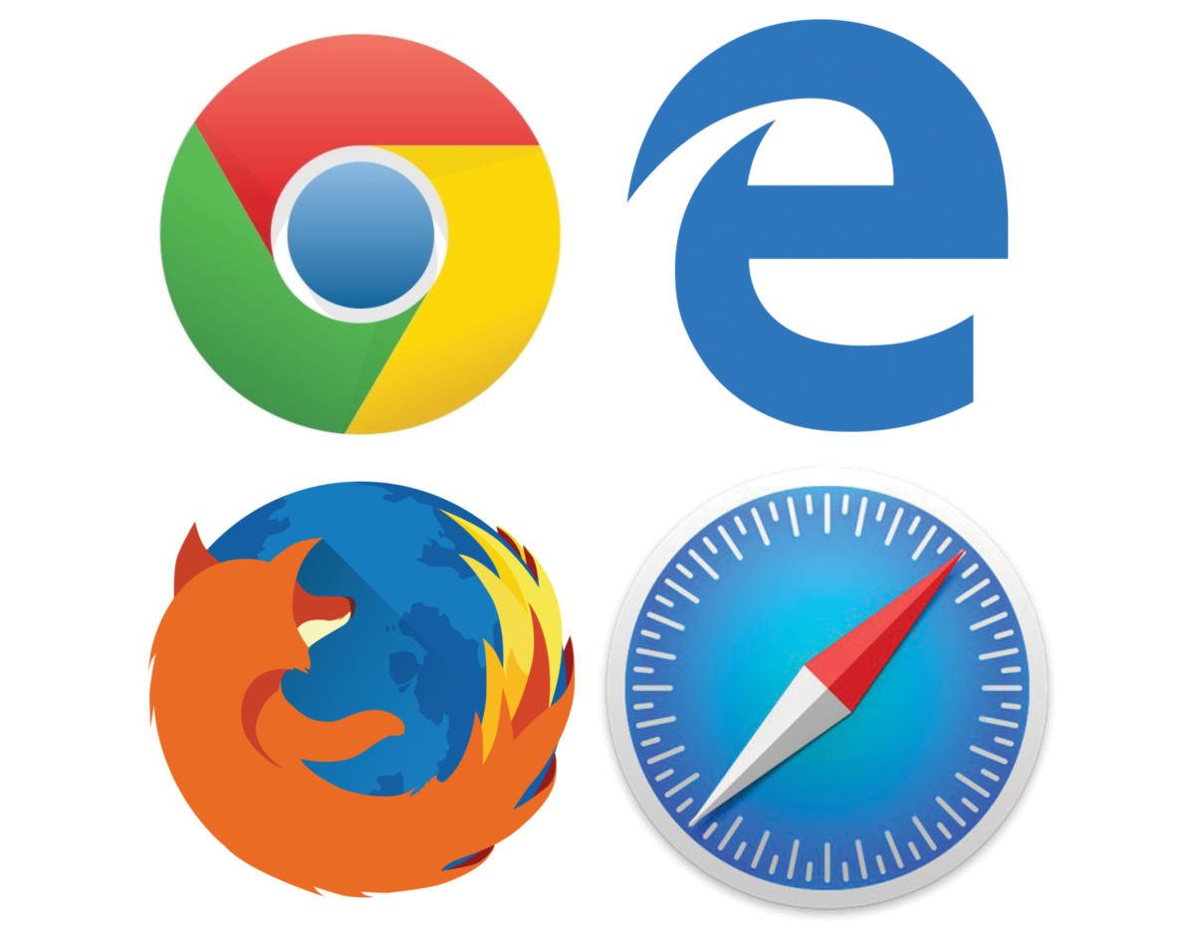
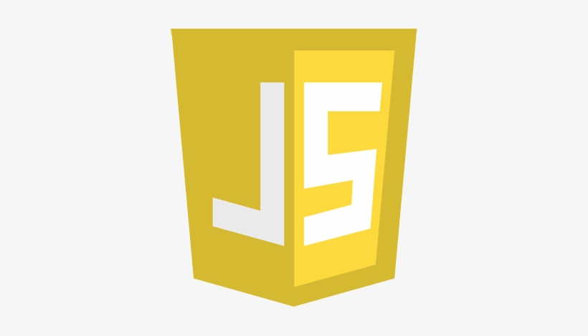
Lab 2b – Solution Design for Kafka Topic Watcher
Every event consumed from a Kafka Topic is pushed to the browser as Server Sent Event
Kafka Topic Watcher
Node application runs HTTP Server and subscribes to all topics in the configured Kafka Cluster

Slide 80
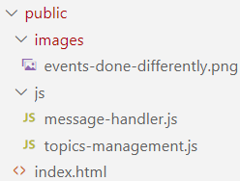
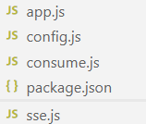
message-handler.js
index.html
topics-management.js
/updates
/config
/topics
app.js
handleMessage
sse.js
consume.js
config.js

Slide 81
Lab 3 – DIY CQRS
Handles new and changed customer details – including Mandate Setting for Connection Identifier
REST API Call to POST/PUT or GET customer details including Mandate
REST API Call to GET Mandate Setting
Publish Event to Kafka Topic for every new or changed Mandate Setting
CRM
IoT Platform
Need to have the SmartMeter Mandate Setting for every ConnectionId for
Consume Event and Record new Mandate Setting for Connection Identifier
csv

Slide 82
Overview
What is Apache Kafka? Core concepts and technology
Lab 1 – First hands-on with Apache Kafka
Programming against Apache Kafka
Brief introduction of Node (JS)
Lab 2 – Programmatic interaction with Apache Kafka
Shades of Data – Streaming, CQRS, Event Sourcing
The Eneco Case – The Event Streaming Platform
Lab 3 – DIY CQRS
Microservices and the quest for decoupling
Lab 4 – Microservices Choreography
But wait – there is more:
Schema Registry, Connect, Streams, KSQL
Pulsar, Solace, RabbitMQ and the Public Cloud Vendors: Azure Event Hub & Stream Analytics, OCI Streams, AWS MSK,

Slide 83

Final Demo
Microservices
Microservice

Slide 84
Microservice Objectives
Business Agility in functionality:
Quick and flexible, cheap, effortless and risk free
Develop/evolve
At scale (teams)
Agile
Innovative technology
Quick ramp up (new team members)
Manage
Agile (quick, automated, reliable rollout)
Scalable (scale-out horizontably, pay per usage)
Reliable and Resilient
Physically distributed
Robust (if one part fails, not everything is dragged down)

Slide 85
What is IT all about?
Production Runtime
Application

Slide 86
What is IT all about?
Production Runtime
Application
Business value
Platform

Slide 87
What is IT all about?
Production Runtime
Operations
Monitoring & Management
Application
Platform
Platform
Platform

Slide 88
Production Runtime is the Result of Preparation Runtime
Preparation Runtime
Production Runtime
Development
Operations
Monitoring & Management
Application
Application
Agile Design, Build, Test
Platform
Platform
CD

Slide 89
One team has Agile responsibility through full lifecyle
Preparation Runtime
Production Runtime
Development
Operations
Monitoring & Management
Application
Application
Agile Design, Build, Test
Platform
Platform
CD

Slide 90
One team has Agile responsibility through full lifecyle
Preparation Runtime
Production Runtime
DevOps
Development
Operations
Monitoring & Management
Application
Application
Agile Design, Build, Test
Platform
Platform
CD
You build it, you run it, you fix it, you evolve

Slide 91
One team has Agile responsibility through full lifecyle
DevOps
Application
Application
Platform
Platform
You build it, you run it, you fix it, you evolve

Slide 92
A microservice is owned by one team through its full lifecyle
DevOps
Microservice
You build it, you run it, you fix it, you evolve

Slide 93
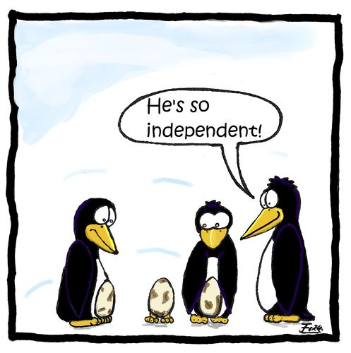
Microservices
Agile | Flexible | Scalable | (Re)Deployable
Independent | Decoupled | Isolated
Have their own private bounded context – the data they require to function
Their lifeblood
Communicate asynchronously, via events

Slide 94
The Microservice
HTTP REST/JSON
API
µ

Slide 95
Extended API of microservice
API
Deployment Interface
Injectable dependencies – reference to cache, logging, storage URL, …
Configurable meta-data – run time parameters, log level, credential (key)
Runtime Interaction Interface
REST API Resources & Operations – query and URL parameters, message formats
Events Consumed – alternative way to call | activate a microservice
Reference to entry in Event Catalog
May include reference to shared Cache Resource
Events Produced – alternative output from microservice
Event can be an asynchronous response to a stateless consumer

Slide 96
Microservices State
Generic Platform for running microservices
LDAP
Big Data
Block Storage
Cache
RDBMS
NoSQL
Document Store
Event Hub
Notes:
All data stores are distributed
Or at least distributedly available
They can be local or on cloud (latency is important)
Data in generic data store is still owned by only one microservice – no one can touch it
Only in DWH and BigData do we deliberately take copies of data and disown them

Slide 97
Bounded context of microservices
A micoservice needs to be able to run independently
It needs to contain & own all data required to run
It cannot depend on other microservices
UI
API
Customer
API
Order
CustomerModified event

Slide 98



Demo – Maintaining Derived Data in Bounded Context using Data Change Events communicated cross cloud over Kafka
Customer Microservice
Order Microservice
Customer Modified Event
Application
Application
Event Hub
Customers
Topic
DBaaS

Slide 99
Overview
What is Apache Kafka? Core concepts and technology
Lab 1 – First hands-on with Apache Kafka
Programming against Apache Kafka
Brief introduction of Node (JS)
Lab 2 – Programmatic interaction with Apache Kafka
Shades of Data – Streaming, CQRS, Event Sourcing
The Eneco Case – The Event Streaming Platform
Lab 3 – DIY CQRS
Microservices and the quest for decoupling
Lab 4 – Microservices Interaction and Choreography
But wait – there is more:
Ecosystem and supporting tools
Alternative offerings (public cloud and stand-alone)

Slide 100
Apache Kafka is more than the core distributed event platform And there is more to distributed event platforms than Kafka
Apache Kafka is surrounded by an ecosystem
Primary supporting company: Confluent
Extensions, Tools, Enterprise Edition
Supporting resources (books, articles, tutorials, conferences)
Partner companies
Managed cloud services
Kafka-compatible Public Cloud offerings
Kafka-like offerings
Competitors, imitators, …

Slide 101

Ecosystem – Kafka and Friends
Kafka Schema Registry – manage message schema definitions
Kafka Connect – read data and change events from many sources and/or write to many targets
Also see Debezium
Kafka Streams
Kafka KSQL
Confluent Enterprise
Enterprise Grade Security
Replicator (synch across regions)
Ops (Operations) support
Confluent Managed Kafka Cloud Offering

Slide 102


Confluent offerings

Slide 103


Select Running Count from <stream of tweet events>
select tag
, count(*) tweet_count from tweets Where tag = 'COVID2019' or tag = 'KAFKA'
group by tag
<--- streaming data

Slide 104

Continuous Queries on Streaming Data
Count Events, Aggregate Payloads, Filter, Combine & Enrich…
… and produce: new events
Topic
Processor
Topic
Topic
Processor
Topic
Table

Slide 105



Alternatives for Apache Kafka’s Distributed Streaming Event Platform
Apache Pulsar
Solace PubSub+ Event Portal
Rabbit MQ
Apache Active MQ
Streaming Data libraries
Apache Spark Streaming, Conduit, Faust, Apache Flink, Apache Storm, Samza, Apache Beam, Apache Flume

Slide 106
Managed Kafka (-like) Cloud Offering
AWS
SQS
Managed Streaming for Apache Kafka (Amazon MSK)
EventBridge, Kinesis
Azure
Event Hub
EventGrid, Stream Analytics
Oracle Cloud Infrastructure
Streams
Google Cloud Platform
PubSub
DataFlow
… (Heroku Managed Kafka, Alibaba Cloud LogHub, IBM Event Streams,…)
?

Slide 107



Summary
=> == =>
Apache Kafka is emerging as platform of choice for message exchange in a world of
Microservices
Event Sourcing, CQRS and Data Source Synchronization
Clouds
Fast Data (IoT) and Streaming Analysis
Real time data integration & distribution
Getting started with Apache Kafka is not very hard at all
The platform is open source – and has broad client support (Java, Node, …)
Many resources are available – tutorials, blog article, demonstrations, presentation slides and recordings of conference sessions, samples on GitHub
Using Docker Compose it is quite easy to quickly run a Kafka Cluster (and with CloudKarafka even easier)
Note: managing a production grade cluster is not so easy

Slide 108
Overview
What is Apache Kafka? Core concepts and technology
Lab 1 – First hands-on with Apache Kafka
Programming against Apache Kafka
Brief introduction of Node (JS)
Lab 2 – Programmatic interaction with Apache Kafka
Shades of Data – Streaming, CQRS, Event Sourcing
The Eneco Case – The Event Streaming Platform
Lab 3 – DIY CQRS
Microservices and the quest for decoupling
Lab 4 – Microservices Interaction and Choreography
But wait – there is more:
Schema Registry, Connect, Streams, KSQL
Pulsar, Solace, RabbitMQ and the Public Cloud Vendors: Azure Event Hub & Stream Analytics, OCI Streams, AWS MSK,

Slide 109
Lab 4
Billing Run Coordinator
1
Asynchronous conversation between microservices
Create bill processing instructions for customers
Handles assignment on workflow queue to produce a bill for a customer
2
workflow-queue
CRM
Billing Engine
questions
3
answers
4
5
Consume Event, handle the question and publish a response with customer details on a second queue – including the conversation identifier
Publish Event to Kafka Topic with question details and conversation identifier

Slide 110
Extended Lab Environment – from docker-compose.yml => docker-compose-full-kafka-stack.yml
2181
9092
9093
9094
Docker Compose
kafka
28044
28042
Browser
Laptop
localhost

Slide 111
Extended Lab Environment – docker-compose-full-kafka-stack.yml
Schema Registry
Kafka Connect 2
2181
Kafka Connect 1
KSQL DB Server
9092
9093
9094
Docker Compose
Kafka Connect UI
Schema Registry UI
KSQL CLI
kafka
28044
28042
28038
28039
Browser
Laptop
localhost

